Slide 1
TIKTOK

Slide 2
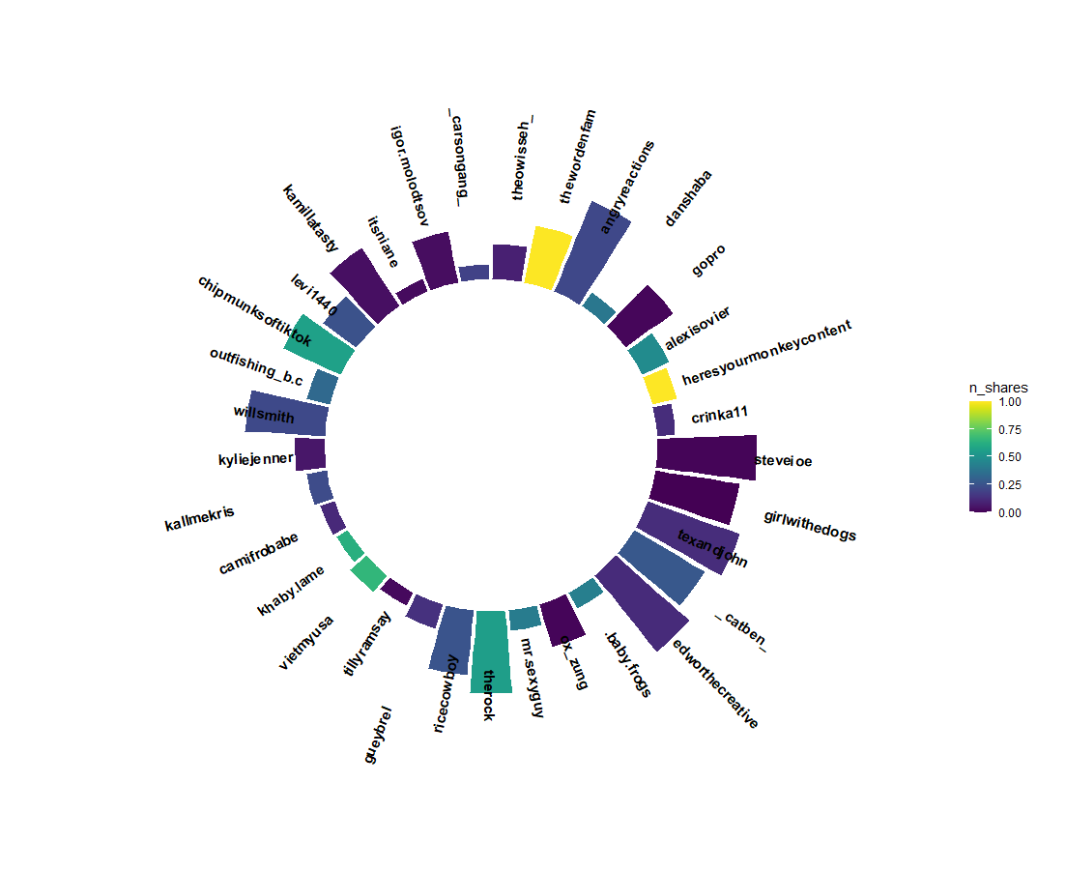
Video Length of Top Trending Users
From least number of likes to max (clockwise):
Thewisseh (min)
_carsongang_ (max)
The colors indicate the amount of time shared (scaled from 0-1)

Slide 3
Wordcloud of most used words in descriptions

Slide 4
Views per video based on top trending users and the number of times shared
Size: number of times shared
Colour: users

